Slide 1
North Runway
Gerry Duggan

Slide 2
Purpose of Presentation
To advise on developments that have taken place since planning permission was granted for the development of the North Runway by ABP in 2007

Slide 3
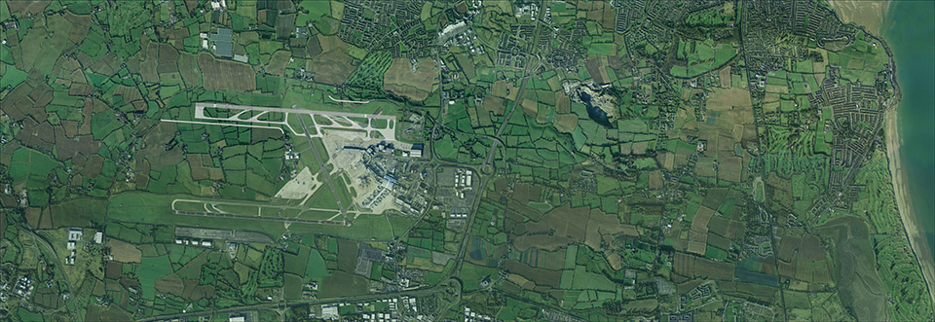
Dublin Airport with North Runway
Runway Requirements are determined by
Aircraft movements rather than Passenger nos.

Slide 4
IAA Annual Report 2015

Slide 6
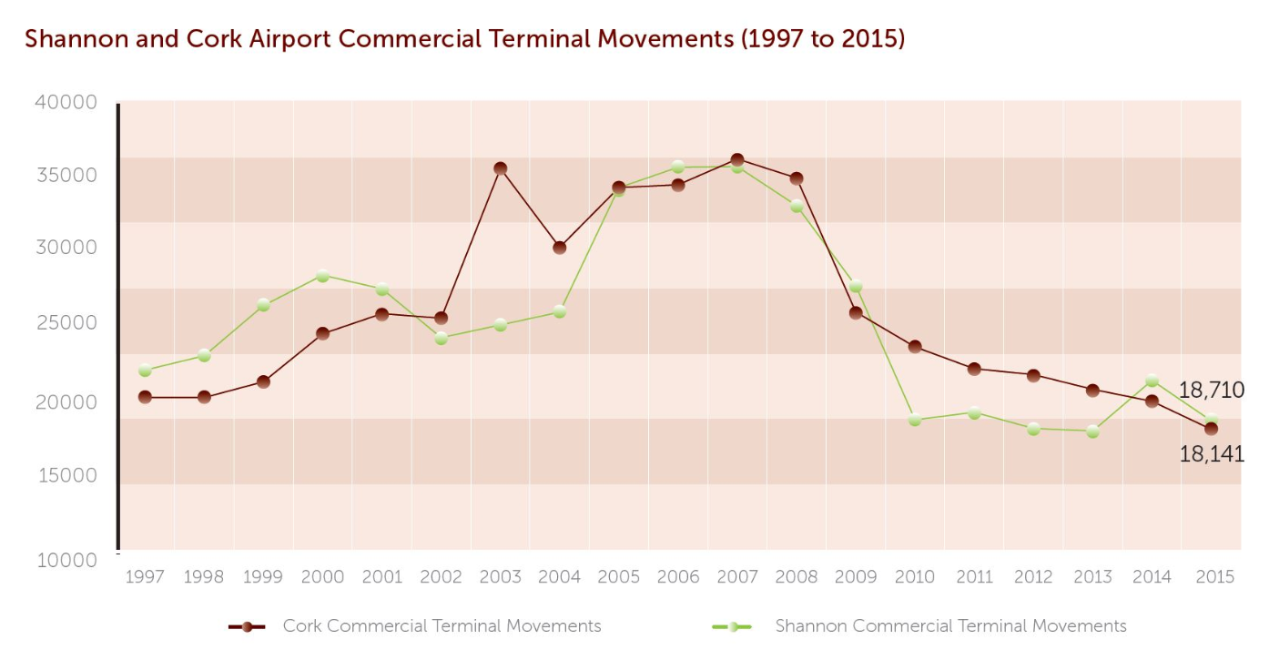
IAA Annual Report 2015

Slide 7
Airport Capacity Constraints
Problem is not a shortage of runway or terminal capacity
Rather it is the sub-optimal and non cost effective utilisation of existing capacity
With completion of motorways to
Galway, Limerick, Cork & Waterford
Dublin is sucking the life out of other airports
If North Runway and Terminal 3 are built, at a total cost of €500m+ the trends indicate that Dublin will end up as the only airport in the country
We need much greater national debate on this issue and its impact on Balanced Regional Development

Slide 8
2007 Planning Permission Conditions
3d North Runway shall not be used for take-off or
landing between 2300 and 0700
On completion of North Runway the avg. no. of night time movements shall not exceed 65/night, between 2300 and 0700
The conditions were proposed to ABP enquiry by DAA
“These conditions are particularly onerous and would restrict the usage of the airport to a degree that would largely obviate the purpose of the new runway”
- Chairman Designate of DAA’s statement to the
Oireachtas Select Committee on TT&S. July 20th 2016

Slide 9
EU Regulation No 598/14 on the establishment of rules and procedures with regard to the introduction of noise related operating restrictions
Noise restrictions should be based on objective & measurable criteria
Such information should be reliable, obtained in a transparent manner and available to Competent Authorities and Stakeholders
Competent Authorities should put in place the necessary monitoring tools
Competent Authorities should be independent of any organisation involved in airport operation, air transport or air navigation services

Slide 10
New Regulatory Regime
IAA designated as Competent Authority, required to
Collaborate with ABP, FCC & the EPA
Consult with local residents and business interests
Adhere to ICAO Balanced Approach
Establish an appropriate and robust appeal
mechanism
but
IAA will not be bound by operating restrictions foreseen in planning permission granted in 2007 for new runway

Slide 12
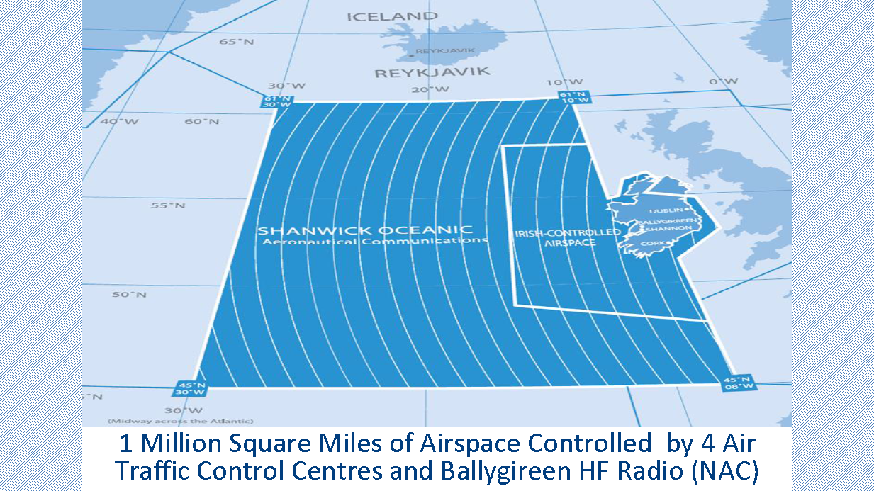

Slide 13
IAA is Financially Independent of Government
2015 Financial Highlights
 | €m
Turnover | 183.4
Operating Profit | 33.6
Profit after tax | 24.8
Dividend paid | 6.5

Slide 14
IAA is Financially Independent of DAA
IAA Turnover 2015
Activity | €m | %
En route | 116.4 | 63.5
Terminal | 21.4 | 11.7
North Atlantic communications | 20.0 | 10.9
Safety Regulation | 20.2 | 11.0
Exempt air traffic | 1.7 | 0.9
Commercial | 3.7 | 2.0
Total | 183.4 | 100.0

Slide 15
IAA presently lacks noise measurement, modelling & impact assessment skills
But it can readily acquire the required expertise
IAA Staff Costs 2015
Wages & Salaries €m Pension Contributions etc. €m Total €m | 60.0 26.0 86.0
No of Employees Average Cost / Employee | 655
Wages & Salaries €000 Pension Contributions etc. €000 | 91.6 39.6

Slide 17
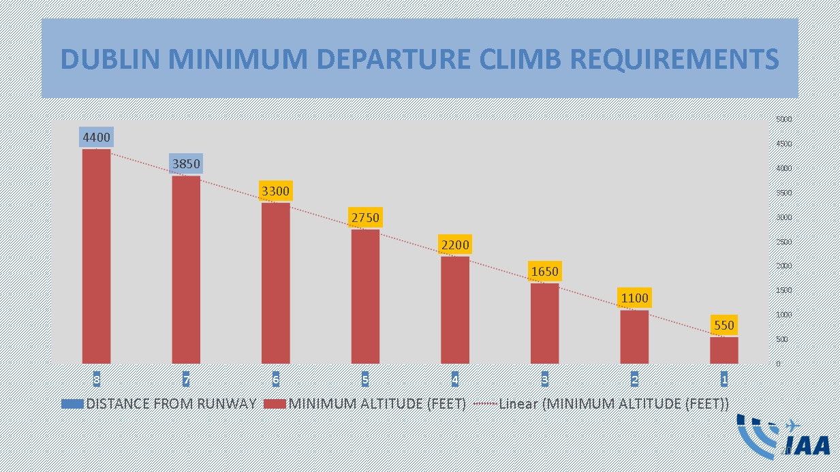

Slide 18
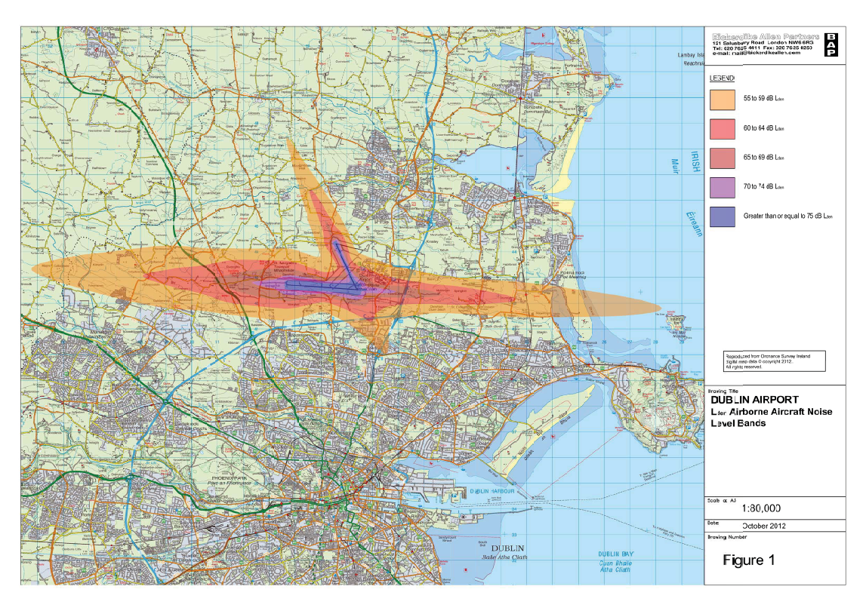

Slide 20
Aircraft Noise and Population Affected
UK CAA states that noise levels are perceived as annoying if noise level exceeds 57 dB(A)Leq Aircraft noise is recognised as being more annoying than noise from other sources, at same noise level
DAA & FCC in their contribution to the 2012 report on noise in Dublin Agglomeration reported that just 500 persons in Dublin are exposed to aircraft noise levels in excess of 55 dB(A)Lden
In Britain the CAA’s latest annual report on the number affected by aircraft noise is
Manchester 32,100
Gatwick 3,200
Stanstead 1,700

Slide 21
Impact of North Runway on Noise Problems
DAA in its submission to 2007 planning enquiry contended that the additional runway would not increase the numbers significantly affected by noise
This contention was effectively dismissed by ABP
Now DAA have stated that “Securing the optimum use of runway system will require the examination of a divergence in departure flight paths from “straight out” for North Runway”
This mode of operation was never considered at the runway planning hearings, nor is it provided for in FCC’s Co. Development Plan, or its current Draft Development Plan

Slide 22
Independent Departure Rules
ICAO requirement is that departing flights diverge at a minimum of 15 degrees following take off
IAA advised that this could be achieve by the divergence of either or both runway departure paths
IAA also advised that, if adopted, this mode of operation would apply throughout the day & night
This proposal very substantially widens the range of households potentially affected by significant aircraft noise

Slide 23
Possible Divergent Flight Paths for Departing Aircraft

Slide 24
Noise Restrictions at large European Airports
city
Airport | DUB | BCN | BRU | CPH | DUS | FRA | MAN | MAD | PMI | ZRH
PX nos m | 25.2 | 39.7 | 23.5 | 26.6 | 22.4 | 61.0 | 23.1 | 46.8 | 23.7 | 26.2
City Center km | 13.1 | 13.4 | 13.7 | 13.2 | 10.3 | 15.3 | 15.5 | 16 | 9.7 | 10.3
Restrictions
APU | X | √ |  | √ | X | X | √ |  | √ | √
Night Curfew | X | √ | √ | √ | 9-5 | 11-5 | √ | √ | X | 9-5
Noise Budget | X | √ | √ | √ | X | X | √ | X | X | X
Noise Limits | X | √ | √ | √ | X | √ | √ | X | X | X
Noise Surcharge | X | √ | √ | X | √ | √ | √ | √ | √ | √
Operating Quota | X | √ | √ | X | √ | √ | √ | X |  | X
Insert Text

Slide 25
Ground Transportation Issues
Dublin Airport is now the largest traffic generator in the State
M50 will reach saturation levels at peak times by next year, and TII have no plans to upgrade northern section
Dublin is only airport of its size in Europe without direct rail link
No provision for such a link in Capital Programme 2016-2022
Much of the local road network serving the airport is substandard
Solving these problems will cost in excess of €3 Bn

