Slide 1
FinGal Organised Residents United movement ( FORUM)
Presentation on Aircraft Noise ( Dublin Airport) Regulation Bill 2018

Slide 2
WHo are forum and who do we represent!
FORUM is an Umbrella group representing Local Community Groups and Resident Associations concerns over the expansion of Dublin Airport and in particular the retention of 2007 planning conditions 3 and 5 which come into force when the new runway is built
Members include
Portmarnock Community Association; Malahide Community Forum ; Rivervalley Residents Association ;Hollystown Concerned Residents ;Chamley Park Residents ;Bissets Lane Residents; Kinseally Residents Association; St Margarets The Ward Residents Association; Ridgewood Residents Association Boroimhe Residents Association; Drynam Hall Residents Association ;Tyrrelstown Residents Association ;Chapelwood Residents Association

Slide 3
FORUM objects to the Minister’s proposal to appointment Fingal County Council as the competent authority for the following reasons –
It has shown itself to be biased in favouring the Dublin Airport Authority over the needs of local communities in it’s decisions over the years
It has no competence in the field of developing rules in relation to Airport Noise
There would be no public trust in any rules and procedures that would be developed by Fingal County Council
Ultimately the rules and procedures will be developed to protect the health of workers at the airport and people living in communities adjacent to the airport. Fingal County Council have no health expertise
Noise generated by aircraft emanate from the engines and design of the aircraft structure. Fingal County Council have no expertise in aeronautical engineering and aircraft design
Fingal County Council are beholden to Dublin Airport as they derive 20% of their rates income from the Dublin Airport Campus

Slide 4
FORUM objects to the Minister’s proposal to appointment Fingal County Council as the competent authority for the following reasons –
The salary scales that will need to be offered to attract competent persons for posts in a competent authority are likely to be so high that they would breach salary scales in Fingal County Council
Specialist professionals with noise expertise in the Aviation sector are unlikely to be attracted to posts offered by Fingal County Council as there will be no career progression path for them within Fingal County Council.
The Chief Executive of Fingal County Council in a meeting with FORUM on the 18th October 2016 indicated that they would not be in a position to dictate to the Dublin Airport Authority as they received 20% of their rates income from the DAA
Fingal County Council are also in receipt of substantial fees from new developments at Dublin Airport

Slide 5
FORUM favours the appointment of The Commission for Aviation Regulation (CAR) as the Competent Authority
The Minister has indicated that he intends merging the regulatory functions of the Irish Aviation Authority with those of the Commission for Aviation Regulation. This would mean that the enlarged organisation would be responsible for aircraft registration, aircraft safety, licensing of all pilots, licensing of aircraft maintenance staff and setting of landing charges.
FORUM favours the appointment of the Commission for Aviation Regulation as the competent authority for the setting of rules and procedures with regard to the introduction of noise related operating restrictions at Dublin Airport as it will have already have expertise in all areas of aviation with the exception of noise. The addition of noise expertise will result in an aviation regulation organisation of world standard.

Slide 6
What do Local Communities Require?
A Competent Authority be appointed to develop a set of rules and procedures with regard to the introduction of Noise Related Operating Restrictions at Dublin Airport within a balanced approach under EU regulation 598/2014
The Competent Authority must be totally independent

Slide 7
What do Local Communities require?
Fingal County Council do not meet the criteria of independence needed under Regulation 598/14
1) They get up to 20% of their Ratable income from the DAA
2) The power of the competent authority in the Aircraft Noise (Dublin Airport) Regulation Bill 2018 is delegated to The CEO and this Deputy ( Conflict of interest with his role as CEO of Fingal CC and Fingal planners
3) Local Councillors will not be able to discuss matters with the Regulator
4) No Aviation or Acoustic expertise in House
5) Will never be viewed as Independent by Local Communities and the general public

Slide 8
What do Local Communities require ?
Comprehensive Plan to protect communities around Dublin Airport
Among the issues that need to be addressed the following need to be included
An insulation plan for all housing and public buildings
Upgrade on Motorways and development of new major road to the north and west of the Airport
Upgrades on roads around Dublin Airport and surrounding communities
Cycleway and footpath access from local communities to Dublin Airport
METRO North to be developed
DART connection from Clongriffin station to Dublin Airport to cater for DART and Mainline (Dublin-Belfast) passengers
Electric buses for all local services to Dublin Airport to reduce air pollution
Comprehensive tree planting programme to reduce noise levels around Dublin airport
Housing plan for residents who will be vacating their houses due to increased noise levels
Substantial community funding for local residents
Support for environmental programmes in EU designated Special areas of Conservation and Special Protection Areas around Dublin Airport

Slide 9
Forum Position on Aircraft Noise (Dublin Airport) Regulation Bill 2018
The EU Regulation 598/2014 must be brought into Irish Legislation “to establish rules and procedures with regard to the introduction of noise-related operating restrictions at Union Airports” using the *ICAO Balanced Approach. All communities around Dublin Airport agree with the above statement in the Bill
All communities around Dublin Airport agree on the need to develop Dublin Airport for the benefit of the economy. They agree that the passage of the Bill should be undertaken in a timely fashion
No group in FORUM has ever denied the need for the new runway.
All groups in FORUM are agreed on the need to appoint a Competent Authority who will develop the noise -related restrictions around Dublin Airport on a totally independent basis
We agree on the need to have regulatory clarity to ensure that airlines using the airport are not held up in making investment decisions to base aircraft at Dublin Airport
Benefits of the New Runway
FORUM is happy to see that the new runway will benefit tourism, trade and FDI. The future of all communities in Fingal is dependant on the benefits (especially the jobs) that will result from the new runway at Dublin Airport.
New Legislation
The development of holistic noise restrictions airport-wide and in surrounding areas which will protect the health of workers, passengers and the population of nearby communities using the ICAO Balanced Approach is welcomed by FORUM representing local communities

Slide 10
Forum Position on Aircraft Noise (Dublin Airport) Regulation Bill 2018
Competent Authority
FORUM is very anxious that the body appointed as the Competent Authority Is totally independent and not beholden to any organisation or group who could possibly exert undue influence in the development of the ICAO Balanced Approach. Forum is also anxious that communities will be have the ability to apply for a review of the operating restrictions as set out by the Competent Authority.
The Competent Authority must, in the first instance, have the trust of all stakeholders that it will undertake its duties without fear or favour. If this is not the case the trust of all stakeholders in the noise regulations will be destroyed before they can even be put into force.
Negotiation rights in addition to consultation rights are essential for communities if they are to have trust in the Competent Authority
Stakeholder Engagement
FORUM will be energetic and cooperative in negotiating and consulting with all parties, including the Competent Authority with the aim of participating in the development of a set of fair noise-related operating restrictions using the ICAO Balanced Approach at Dublin Airport and in surrounding areas.
*ICAO – International Civil Aviation Organisation (a specialised agency of the United Nations)

Slide 11
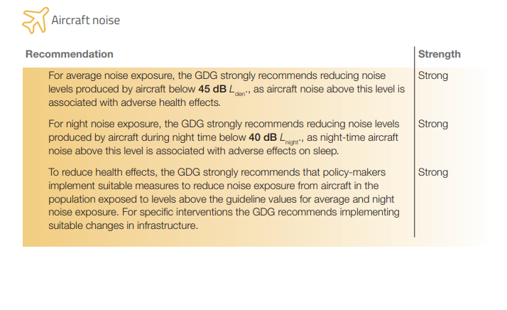
Forum Position on Aircraft Noise (Dublin Airport) Regulation Bill 2018 and NEW WHO Guidelines
The World Health Organisation recently published new Guidelines on noise based on scientific studies Environmental Noise Guidelines for the European Community
Forum wants these guidelines to be enacted into Irish Law and followed as part of the Aircraft Noise( Dublin Airport) Regulation Bill 2018
Night Time MAX noise now 40dB recommended by WHO

Slide 12
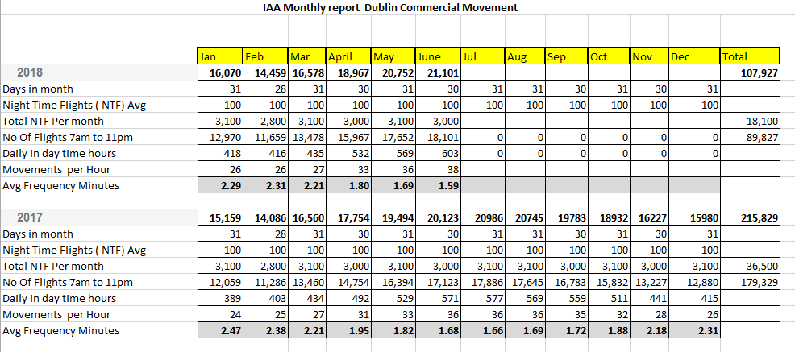
Forum Position on Aircraft Noise (Dublin Airport) Regulation Bill 2018
Respite from Aircraft Noise – during day time hours in June 2018 there was a take of or landing every 1.59 minutes. We need Restrictions at night!

Slide 13
Forum Position on Aircraft Noise (Dublin Airport) Regulation Bill 2018
FORUM recommends that Commission for Aviation Regulation (CAR) be appointed as the Competent Authority for Noise Regulation
Please contact your party and Oireachtas members to inform them on this issue
PROTECT WORKERS AT DUBLIN Airport and LOCAL COMMUNITIES
Contact FORUM
residentsassociationforum@gmail.com
THANK YOU FOR READING THIS PRESENTATION

